Slide 1


Intelligent Content Management System
Mhd Sami Al-Esh Mohannd Al-Tabbaa Mouaz Al-Khodari Mhd Alaa Khair Allah

Slide 2
Project Idea
Providing an Intelligent platform for Managing Arabic content
Raising the quality of digital content for Arabic language

Slide 3




Project goals
Extracting key phrases for Arabic content
Greater integration with SEO principles
Providing means to facilitate the work of Arabic content makers

Slide 4
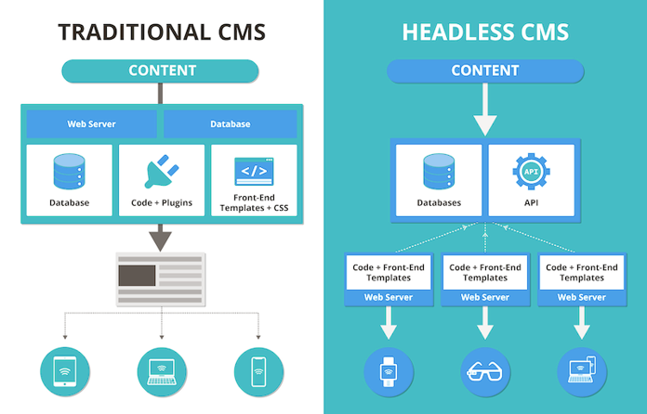

Slide 5



Content Management System Types
Headless
Traditional

Slide 6








Project Blueprint
01
Content Management
04
Image Captioning
07
Optical character recognition
03
06
Key Phrase Extraction
Search
02
05
08
Permissions Control
Face Recognition
spell checker

Slide 7
Key Phrase Extraction
Key Phrase Extraction
Statistical
Graph based
Embed Rank
TF-IDF
Position rank
DOC2VEC
Bert
Topic rank

Slide 8
Key Phrase Extraction
Key Phrase Extraction
Statistical
Graph based
Embed Rank
TF-IDF
Position rank
DOC2VEC
Bert
Topic rank

Slide 9
Key Phrase Extraction
Key Phrase Extraction
Statistical
Graph based
Embed Rank
TF-IDF
Position rank
DOC2VEC
Bert
Topic rank

Slide 10
Key Phrase Extraction
Key Phrase Extraction
Statistical
Graph based
Embed Rank
TF-IDF
Position rank
DOC2VEC
Bert
Topic rank

Slide 11
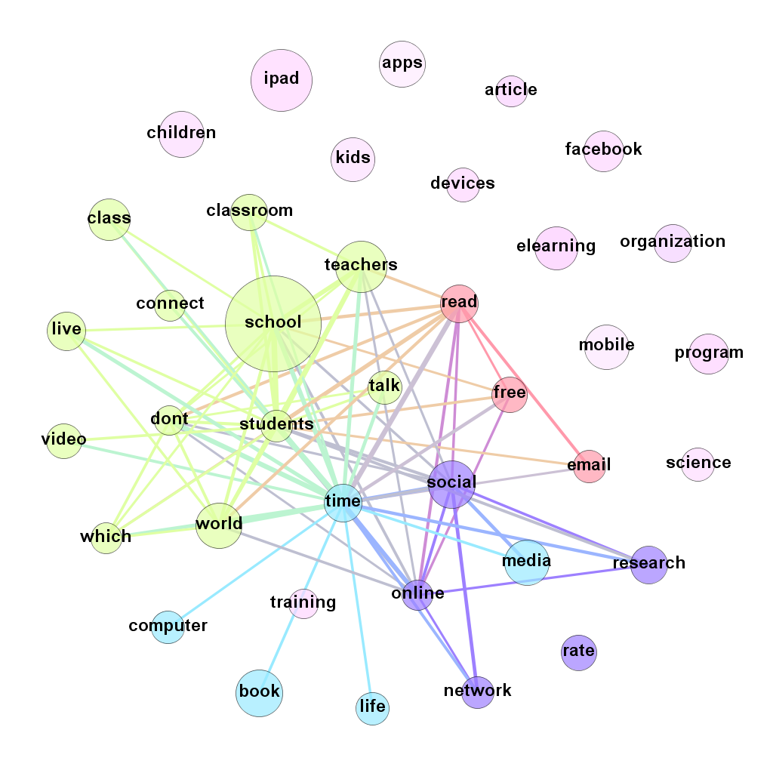
Position rank

Slide 12
Key Phrase Extraction
Key Phrase Extraction
Statistical
Graph based
Embed Rank
TF-IDF
Position rank
DOC2VEC
Bert
Topic rank

Slide 13
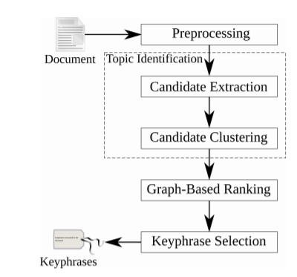
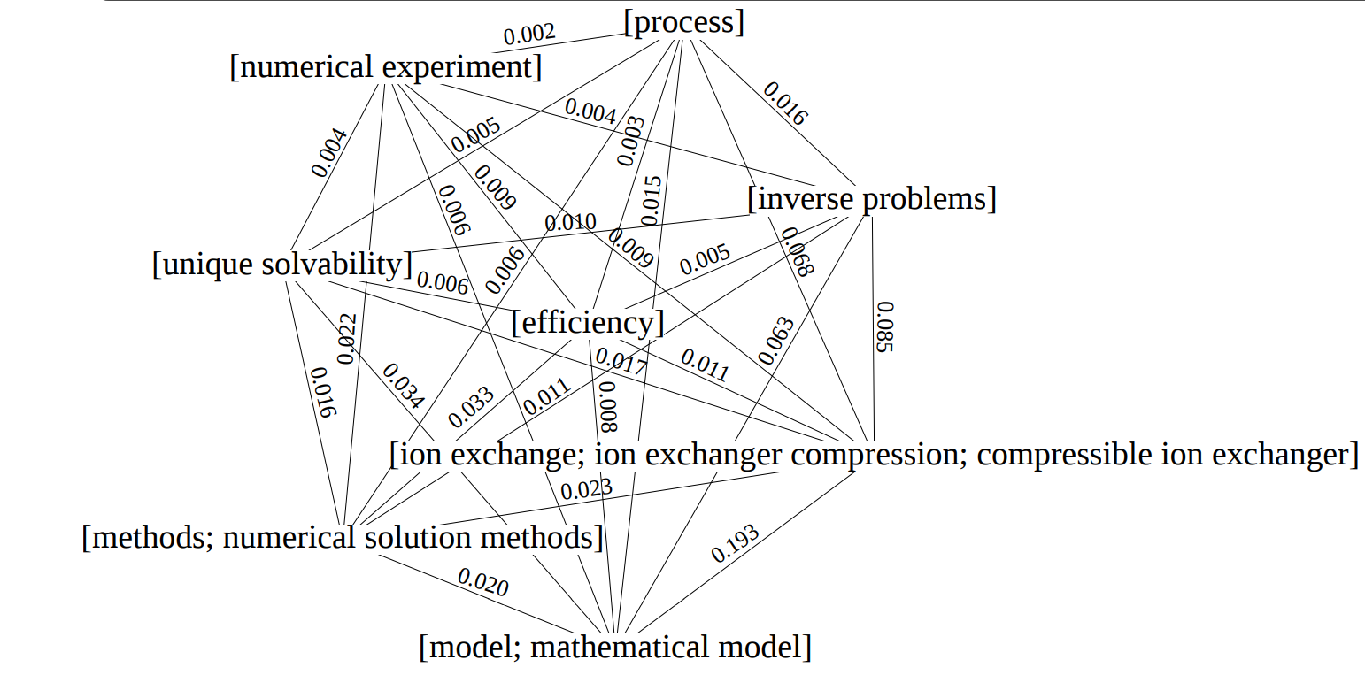
Topic rank

Slide 14
Key Phrase Extraction
Key Phrase Extraction
Statistical
Graph based
Embed Rank
TF-IDF
Position rank
DOC2VEC
Bert
Topic rank

Slide 15
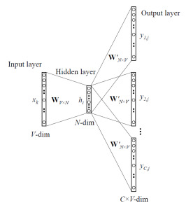
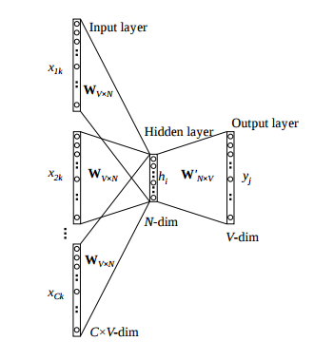
DOC2VEC
Skip-gram
CBOW

Slide 16
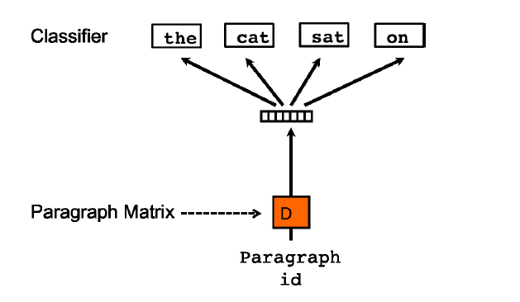
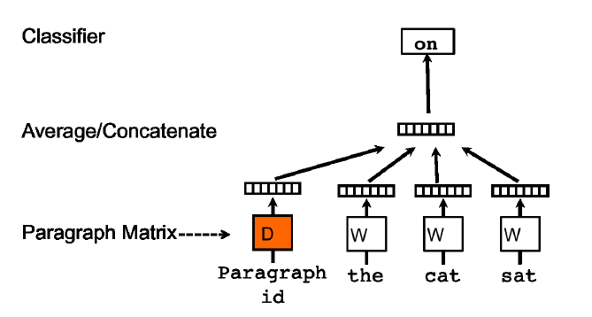
DOC2VEC
PV-DBOW
PV-DM

Slide 17
Key Phrase Extraction
Key Phrase Extraction
Statistical
Graph based
Embed Rank
TF-IDF
Position rank
DOC2VEC
Bert
Topic rank

Slide 18
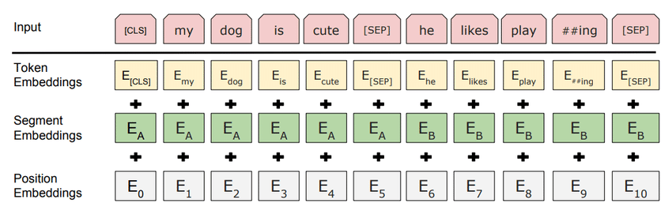
Bert

Slide 19
Key Phrase Extraction
كشفت تقارير صحافية، عن رغبة ليفربول الإنكليزي، في التعاقد مع سيرجيو راموس، قائد ريال مدريد، خلال الفترة المقبلة.
وقال برنامج "الشيرينغتو" الشهير إن ليفربول يريد التعاقد مع راموس لتدعيم خط دفاع الفريق، الذي يعاني كثيراً في ظل غياب فيرجيل فان دايك وغوميز وجويل ماتيب.
ولم يكشف التقرير الإسباني، عما إذا كان "الريدز"، يريد التعاقد مع راموس، خلال فترة الانتقالات الشتوية الحالية، أم سينتظر حتى نهاية عقده في الصيف المقبل."
وينتهي عقد راموس مع "الميرنغي" في نهاية الموسم الحالي، ولم يدخل في مفاوضات لتجديد عقده حتى الآن مع "الملكي"، كما يحق له الرحيل بالمجان عن فريقه في الصيف المقبل.
وارتبط قائد ريال مدريد، بالانتقال إلى العديد من الفرق، على رأسها باريس سان جيرمان الفرنسي، وبعض الفرق الإنكليزية والإيطالية.
output
'الريدز', 'راموس', 'ليفربول', 'وغوميز', 'وجويل ماتيب', 'الشيرينغتو', 'ريال مدريد', 'الميرنغي', 'ليفربول الإنكليزي',
'الفرق الإنكليزية والإيطالية', 'فيرجيل فان دايك', 'سيرجيو راموس', 'باريس سان جيرمان الفرنسي'

Slide 20
Exact match
Results without ranking
part of and Includes
Bert
73.3%
Bert
44.2%
Doc2Vec
73.3%
Doc2Vec
44.2%
Topic
9.5%
Topic
4.7%
Position
6.13%
Position
3.3%%
TF-IDF
31.9%

Slide 21
Exact match
Results with ranking
part of and Includes
Bert
32.8%
Bert
19.3%
Doc2Vec
33.7%
Doc2Vec
20.2%
Topic
4.6%
Topic
2.7%
Position
6.1%
Position
2.9%%
TF-IDF
28.8 %

Slide 22

Top-down methodology
1
Image Captioning Model (Arabic)
Encoder-Decoder
2
Responsible for generating Arabic text caption for images.
Based on Show, Attend and Tell
3
End-to-end
4

Slide 23
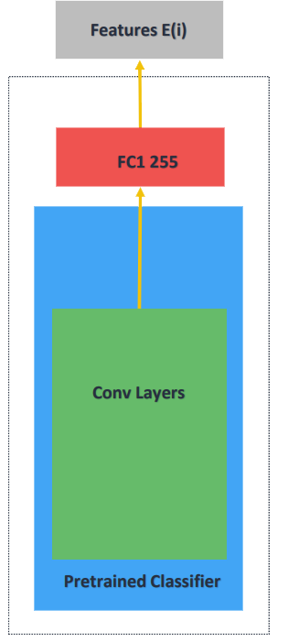
Model Encoder
InceptionV3
The output is the spatial features vector of the image (8x8x2048)
FullyConnected layer is added to be trained
Pretrained on ImageNet (Conv layers only)
Input normalized image dimension (299x299x3)

Slide 24
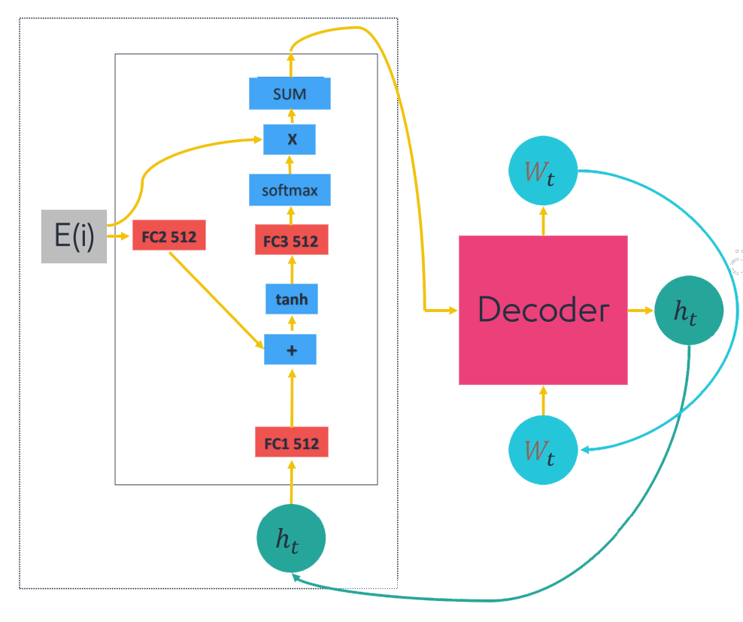
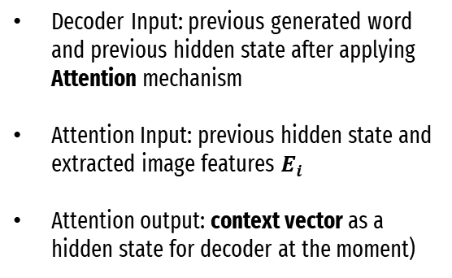
Model Decoder
Attention + GRU
Decoder Input: previous generated word and previous hidden state after applying Attention mechanism
Attention Input: previous hidden state and extracted image features $E_{i}$
Attention output: context vector as a hidden state for decoder at the moment)
Attention

Slide 25
Generated Caption:
"شخص يستخدم الكمبيوتر المحمول على شاشة كبيرة"

Slide 26


Dataset
MS-COCO and Flickr8k
Extract Features
Initialize Datasets
Process the images using InceptionV3
We downloaded the Arabic-translated MS-COCO dataset that was translated using Google Translate API. Also, we downloaded the Arabic-translated Flickr8k dataset.
Tokenize Captions
Preprocess and tokenize the captions
Training
Train the model multiple times
Deployment

Slide 27
Dataset
MS-COCO and Flickr8k
Extract Features
Images Features
Process the images using InceptionV3
We use InceptionV3 (which is pretrained on Imagenet) to classify each image. You will extract features from the last convolutional layer.
Resizing the image to 299x299px
Normalize Image [-1,1]
Store features vectors dictionary
Tokenize Captions
Preprocess and tokenize the captions
Training
Train the model multiple times
Deployment

Slide 28
Dataset
MS-COCO and Flickr8k
Extract Features
Tokenize Captions
Process the images using InceptionV3
Tokenizing gives us a vocabulary of all of the unique words in the dataset.
Limit the vocabulary size to the top-k words (to save memory).
Replace all other words with the token "UNK" (unknown).
Tokenize Captions
Preprocess and tokenize the captions
Training
Train the model multiple times
Deployment

Slide 29
Dataset
MS-COCO and Flickr8k
Extract Features
Train & Evaluate
Process the images using InceptionV3
We train the model on MS-COCO Batch 256/128/64 – Vocab 5k
Tokenize Captions
Preprocess and tokenize the captions
Training
Train the model multiple times
Deployment

Slide 30
Dataset
MS-COCO and Flickr8k
Extract Features
Train & Evaluate
Process the images using InceptionV3
We train the model on MS-COCO Batch 256/128/64 – Vocab 6k
Tokenize Captions
Preprocess and tokenize the captions
Training
Train the model multiple times
Deployment

Slide 31
Dataset
MS-COCO and Flickr8k
Extract Features
Train & Evaluate
Process the images using InceptionV3
We train the model on MS-COCO Batch 256/128/64 – Vocab 10k
Tokenize Captions
Preprocess and tokenize the captions
Training
Train the model multiple times
Deployment

Slide 32
Dataset
MS-COCO and Flickr8k
Extract Features
Train & Evaluate
Process the images using InceptionV3
We train the model on Flickr8k Batch 256/128/64 – Vocab 10k
Tokenize Captions
Preprocess and tokenize the captions
Training
Train the model multiple times
Deployment

Slide 33
Dataset
MS-COCO and Flickr8k
Extract Features
Deployment
Process the images using InceptionV3
Add to strapi
Tokenize Captions
Preprocess and tokenize the captions
Training
Train the model multiple times
Deployment

Slide 34
Results

Slide 35




Face Recognition
feature extraction
face detection
Extract important features from the image and convert them into a beam
Finding the location of all the faces in the picture
face landmark
Finding most similar face
Adjust the direction of the face to get landmark points in certain places
Finding the image that is most similar to the image being searched for

Slide 36
Other services
Optical character recognition
A pre-trained model called Tesseract-OCR was used.
The model extracts the text within the image.
An additional service has been made to extract text from a PDF file.
Spelling checker
Find spelling errors and find corrections by using premade API.
Find formatting errors and write the appropriate correction using regular expressions.

Slide 37
Deployment
We implement Image Captioning using extension
Plugin
Template
We implement Key Phrase Extraction, SpellChecker, OCR and face recogntion using plugins
We gather all plugins and extensions using template mechanism
Extension

Slide 38


Live Demo
Thank you

